Slide 1
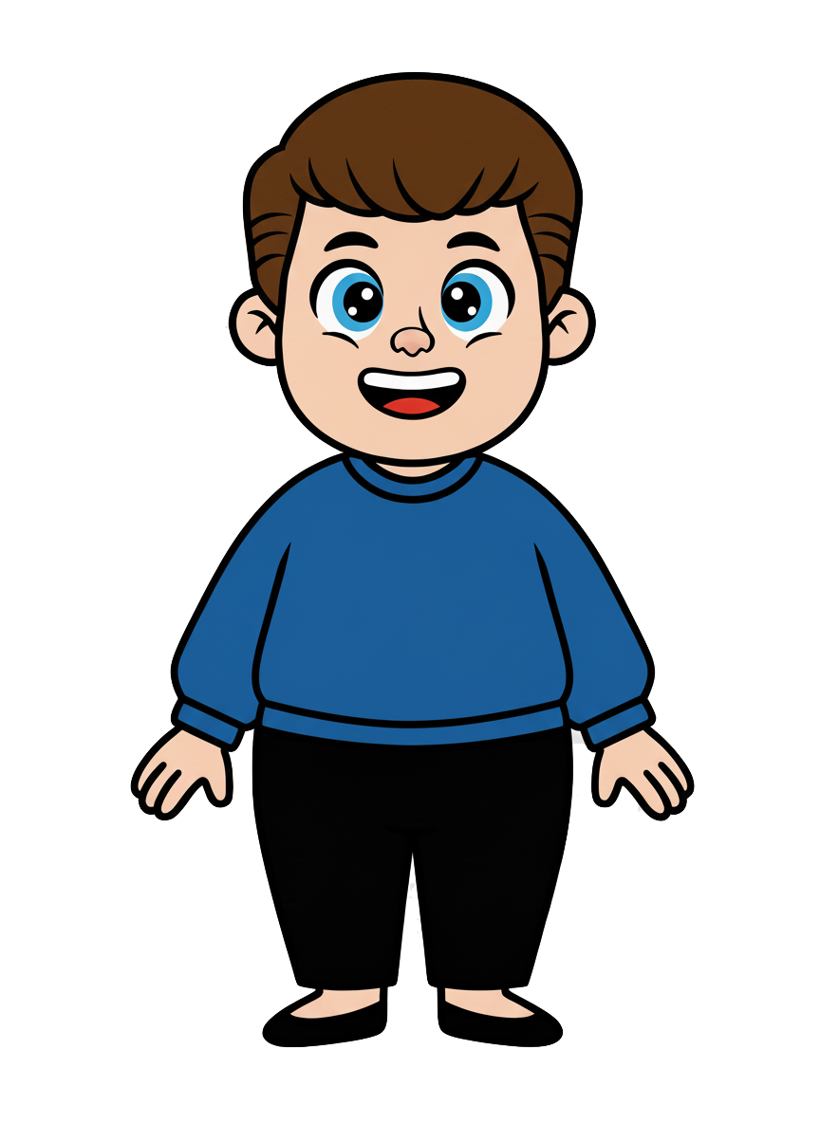
This is Kai

Slide 2

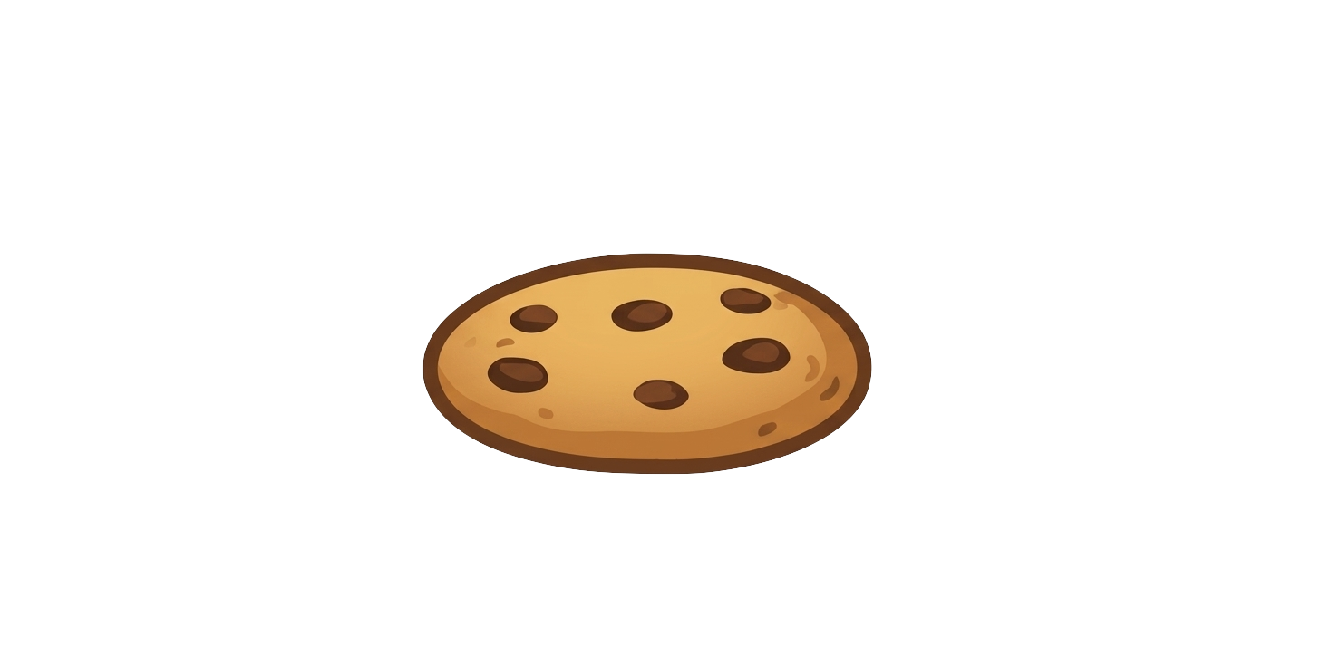
Kai has three
cookies

Slide 3
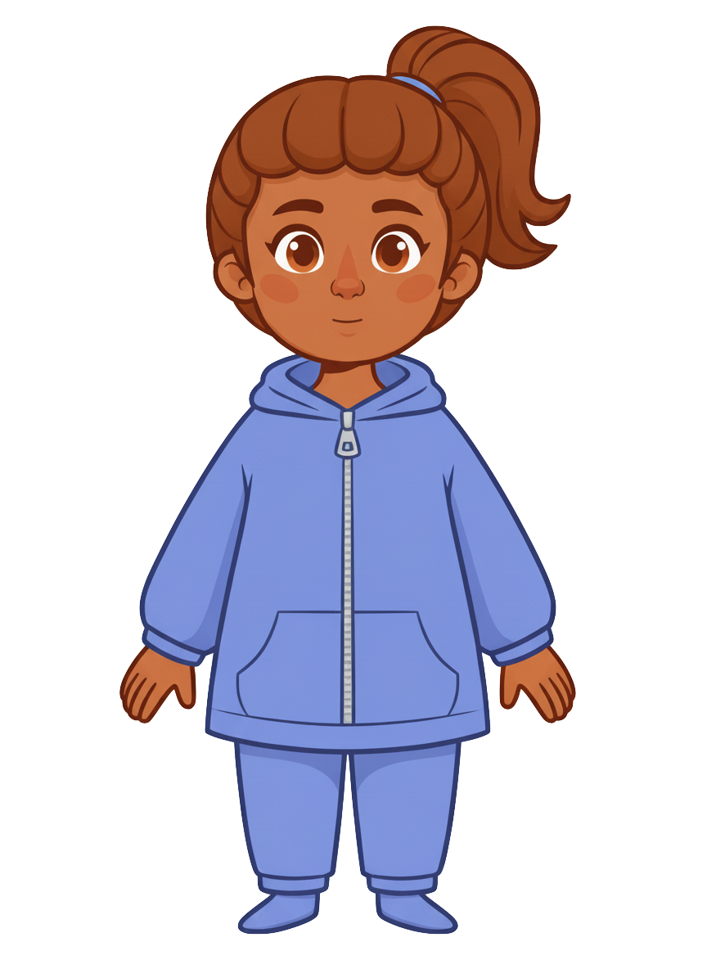
This is Ruby

Slide 4
Ruby has three
cookies

Slide 5
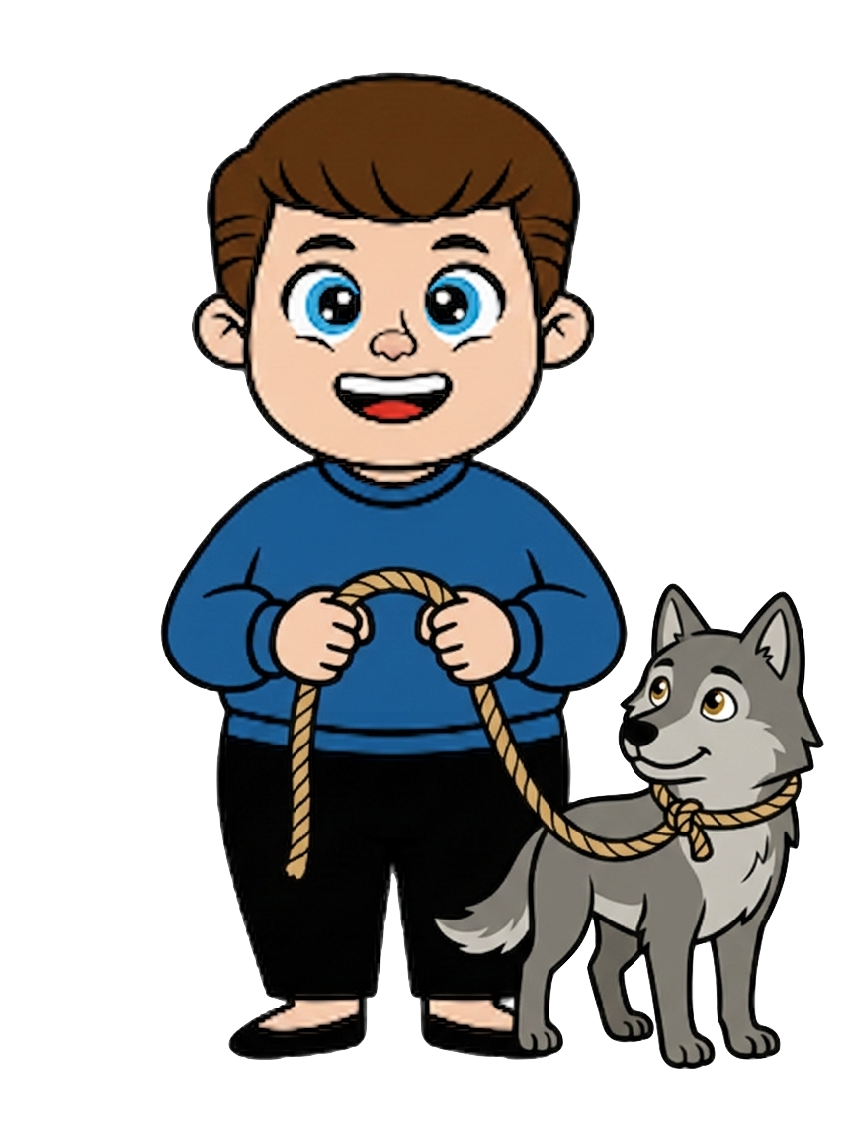
Sam is walking his wolf

Slide 6
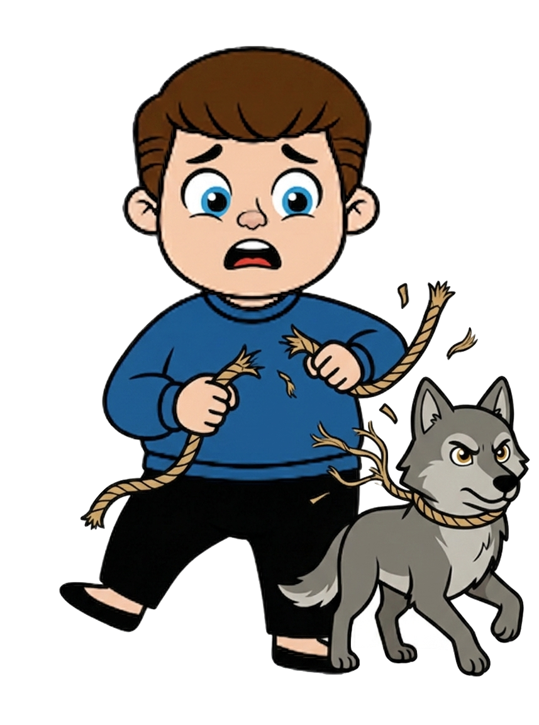
The wolf broke free from the leash

Slide 7
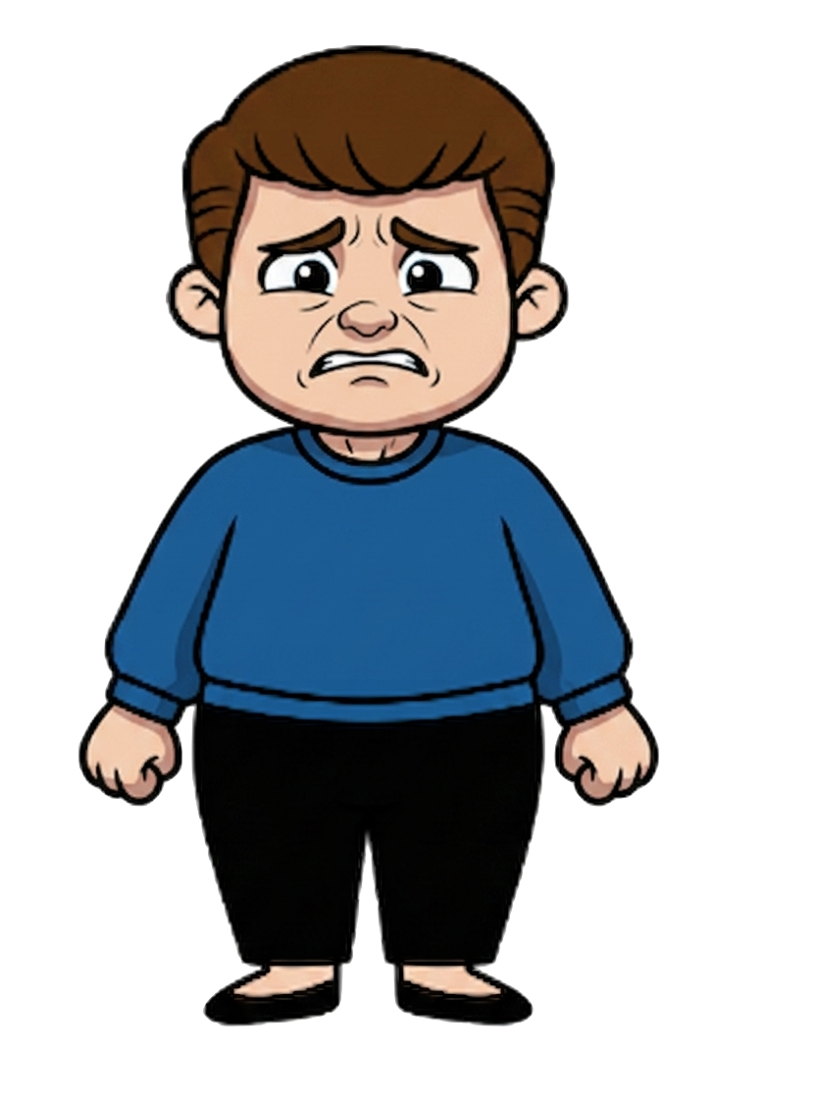
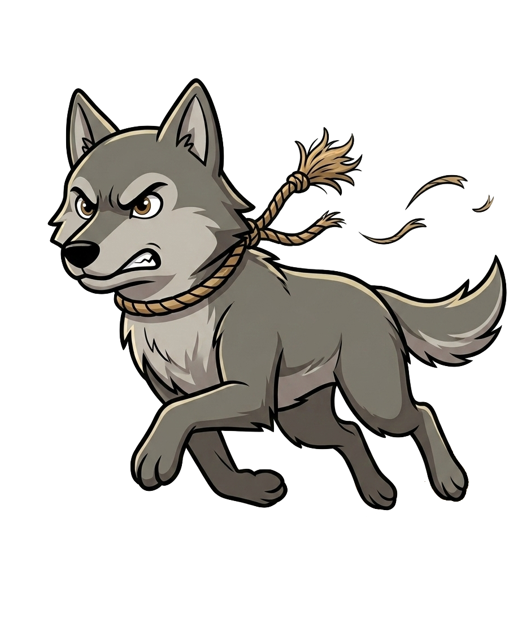
The wolf broke free from the leash

Slide 8
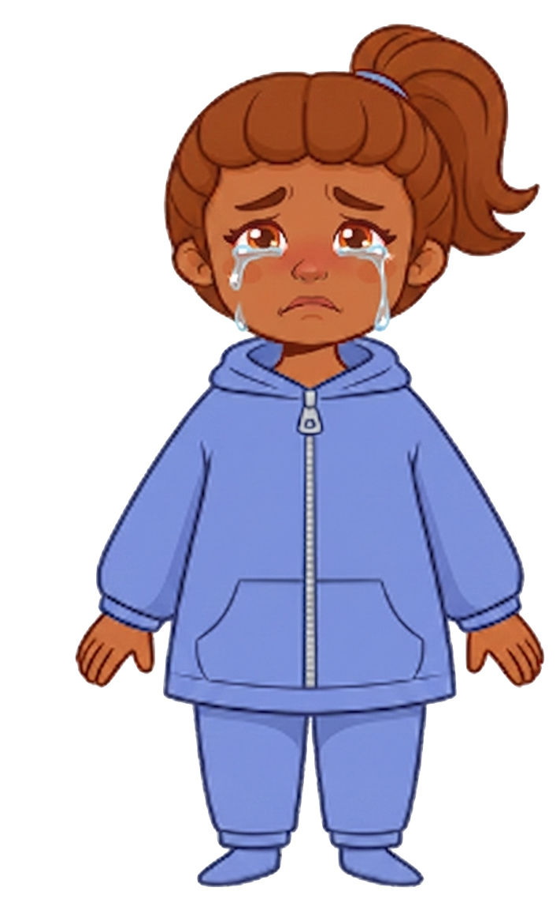
The wolf knocks over 1 of Ruby’s cookies

Slide 9
Kai still has 3 cookies. Ruby now has 2 cookies.

Slide 10
Please decide whether you would like to move some of Kai’s cookies.

